Slide 1
Meme Analytics Bot
AI -powered Meme Scraping, Analysis & Reporting
By: Shaune Ang

Slide 2
Guiding Objective
Give creators an insight for them to have the best chance of getting popular

Slide 3
Table of contents
1
2
3
4
5
6
7
Key Decisions
System Overview
Techstack
Core Features
Report Content
Challenges and Pitfalls
Future Improvements

Slide 4
Key Decisions
Fetching Frequency
NoSQL Database
Popularity Metric
Once every hour to obtain an even spread of data
Flexible semi-structured data
Quick implementation
Up vote count used to determine popularity

Slide 5
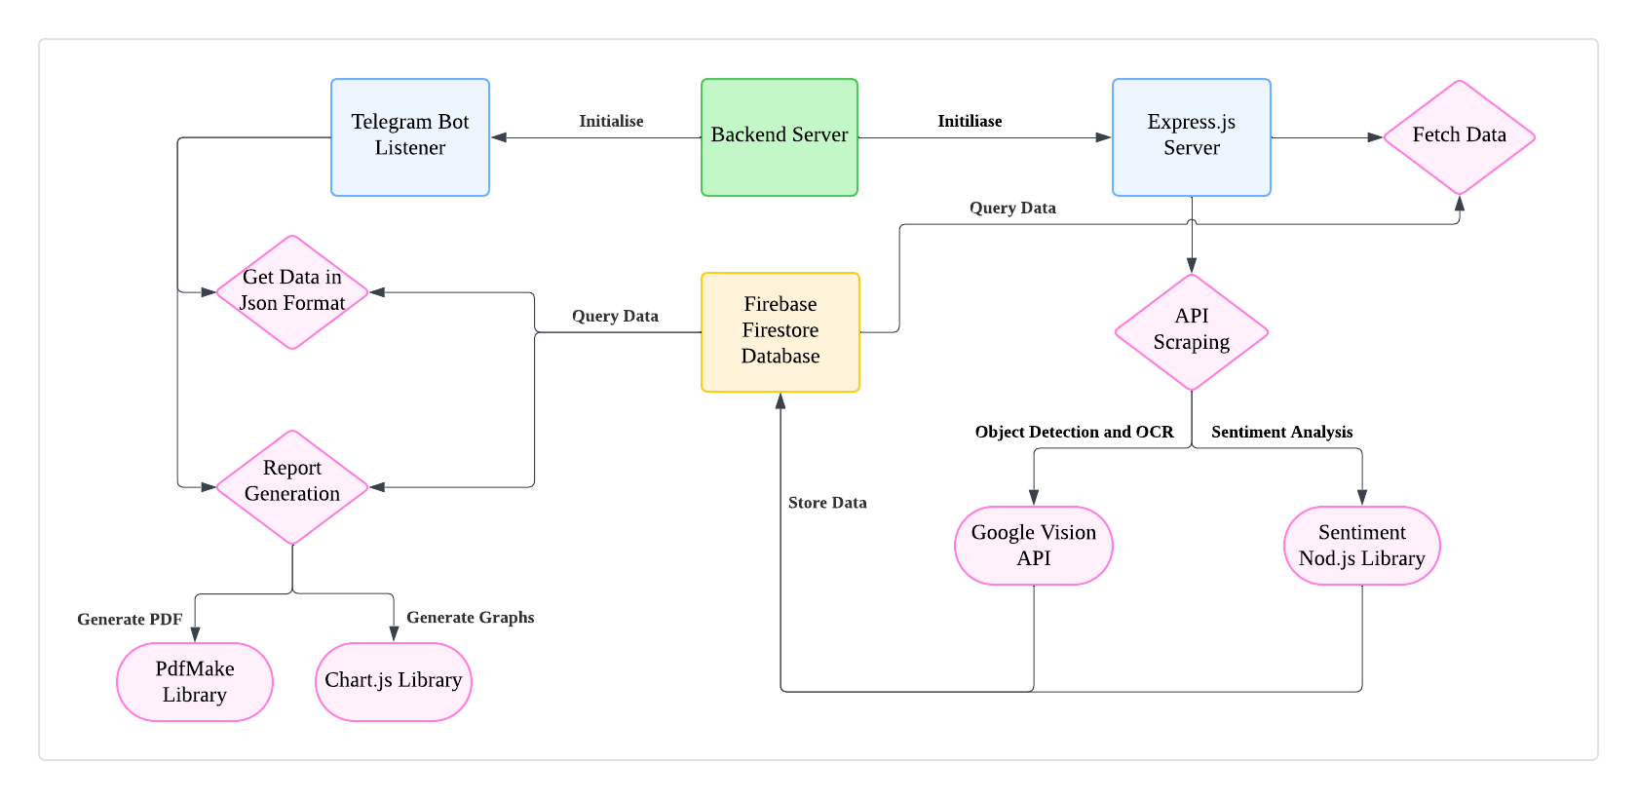
System Overview

Slide 6
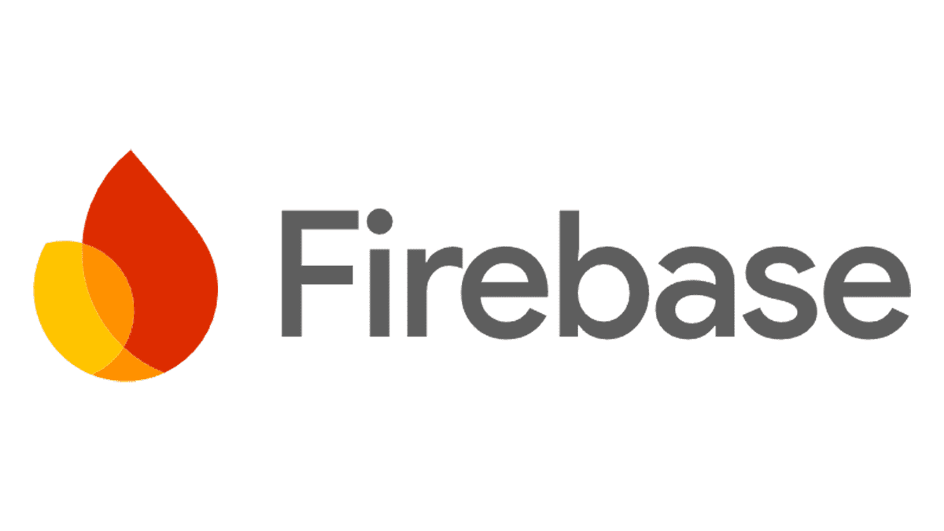



Techstack
Backend | Purpose
Node.js + Express.js | Backend API & server logic
Firebase Firestore | NoSQL database for meme storage
Reddit API | Fetching trending memes
Analysis | Purpose
Google Vision AI | Image recognition & OCR
Sentiment | Sentiment analysis
Compromise NLP | Text analysis & keyword extraction
Report | Purpose
Chart.js + ChartJS Node Canvas | Data visualization
pdfmake | PDF report generation
Telegram Bot API | User interaction

Slide 7
Core Features
Divide the class into small groups of 3-5 students. Assign each group a real-life application for which they will have to use math concepts to solve
Periodically Scrape Memes
1
2
Graph-Based Insights & Trends
Up to date database
Meme popularity over time
Vote ratios & comment trends
Text & image correlation
Topics
Telegram Report Generation
3
4
AI & NLP Meme Analysis
Easy user interaction
Image Text Extraction (OCR)
Sentiment & Keyword Analysis
Object Detection

Slide 8
Report Content
Refer to attached Report Sample

Slide 9
Challenges and Pitfalls
Categorisation of Memes
Keyword Extraction Relevance
Image Recognition and NLP Accuracy
Limited time to train a categorising model
Unable to obtain relevant keywords from meme
Possible Remedy: Reprocess keywords before storing
Constrained to free tier models

Slide 10
Future Developments
Categorical Analysis of Top Performing Memes
Web dashboard with interactive meme analytics, live charts and data
These are some nice-to-have developments that could have been made given more time.
1
2

Slide 11
Thank you!
AI -powered Meme Scraping, Analysis & Reporting
By: Shaune Ang

